Slide 1
I-PASS:
Improving, Disseminating, and Sustaining Safer Handoffs
Christopher P. Landrigan, MD, MPH
Massachusetts Coalition for the Prevention of Medical Errors
March 30, 2017
Notes:
Permissions:
The IIPE logo is used with permission from the Initiative for Innovation in Pediatric Education
The PRIS logo is used with permission from the Pediatric Research in Inpatient Settings Network
Some content in the I-PASS Handoff Study Curriculum includes materials adapted from TeamSTEPPSTM, an evidence-based teamwork curriculum developed by the Agency for Healthcare Research and Quality. All materials are used with permission.
This presentation contains copyrighted materials with permission from Boston Children’s Hospital and the I-PASS Study Group.

Slide 2
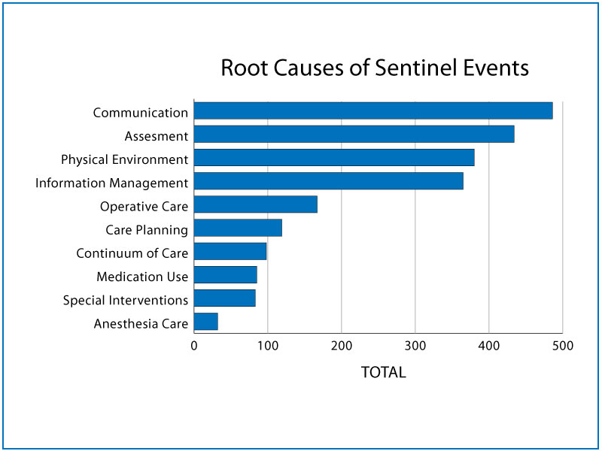
Communication Failures
Joint Commission. (2011). Sentinel Event Statistics Data - Root Causes by Event Type (2004 - Third Quarter 2011)
Notes:
Communication failures, including failures in handoff communication, are the major root cause of sentinel events reported to the JCAHO
Reference
The Joint Commission. Sentinel event statistics data: root causes by event type. http://www.jointcommission.org/sentinel_event_statistics/. Accessed September 27, 2011.

Slide 3
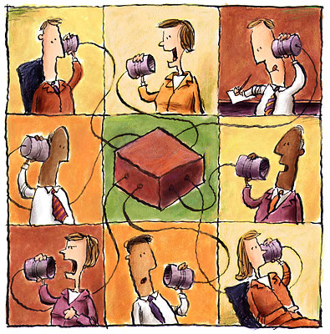



Handoff Bundle Intervention:
Boston Children’s Hospital
Resident
Handoff
Bundle
(RHB)
+
+
=
Communication and handoff skills training
Redesigned Verbal Handoff Process
Mnemonic
+
Computerized Handoff Tool (Unit 1 only)
Starmer AJ, Sectish TC, Simon DW, Keohane C, McSweeney ME, Chung EY, Yoon CS, Lipsitz SR, Wassner AJ, Harper MB, Landrigan CP. JAMA 2013; 310: 2262-2270

Slide 4
Results: Medical Error and Preventable Adverse Events
Rates per 100 Admissions
 | Pre-RHB | Post-RHB | p-value
Medical Errors | 33.8 | 18.3 | <0.001
Preventable Adverse Events | 3.3 | 1.5 | 0.04
Starmer AJ, Sectish TC, Simon DW, Keohane C, McSweeney ME, Chung EY, Yoon CS, Lipsitz SR, Wassner AJ, Harper MB, Landrigan CP. JAMA 2013; 310: 2262-2270
Notes:
Wasn’t an apparent added benefit by med error rates on unit that had computer tool in place
Reviewed 1255 patient admissions for errors
59% full RHB
55% no computer tool

Slide 5

From Pilot Study to
Multi-center Intervention Project…
IIPE-PRIS Accelerating Safe Sign-outs
Multisite study to implement refined handoff bundle for resident physician change of shift handoffs at 9 pediatric institutions
Notes:
To address these gaps in knowledge and further investigate this critical issue we conducted a multi site intervention study named I-PASS, or the IIPE – PRIS Accelerating Safe Signouts study which was a multi-site effort to implement a refined handoff bundle at 9 pediatric institutions.

Slide 6

I-PASS Mnemonic
I | Illness Severity | Stable, “watcher,” unstable
P | Patient Summary | Summary statement Events leading up to admission Hospital course Ongoing assessment Plan
A | Action List | To do list Timeline and ownership
S | Situation Awareness and Contingency Planning | Know what’s going on Plan for what might happen
S | Synthesis by Receiver | Receiver summarizes what was heard Asks questions Restates key action/to do items
Starmer A, Spector N, Srivastava R, Allen A, Landrigan CP, Sectish TC. Pediatrics 2012; 129(2): 201-4

Slide 7

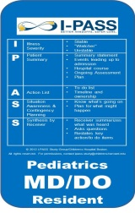

+
+
Mnemonic
Simplified after pilot testing
Emphasizes most essential elements of handoff
Communication and handoff skills training
For Residents
For Faculty
Adult Learning Principles
Multimodal Delivery
Redesigned Verbal Handoff Process
Quiet, Private, Group Handoff
I-PASS
Handoff
Bundle
=
+
+
Campaign and Culture Change
Continual Reinforcement
Faculty Engagement
Printed Handoff Tool
Integrated into every EMR
Structured template if no EMR

Slide 8

Results of Multi-Center Study
A 3-year study on over 10,000 Patients across US and Canada Associated with
a Significant Reduction in Medical Errors and Patient Harm
Number of errors
(rate per 100 patient admissions)
23% reduction
30% reduction
Pre
(n=5516 admissions)
Post
(n=5571 admissions)
P-value
Overall rate of medical errors | 24.5 | 18.8 | <0.001
Preventable adverse events | 4.7 | 3.3 | <0.001
Activity | Pre-Intervention N = 3510 hours | Post-Intervention N = 4618 hours | P-Value
Mean duration of verbal handoff per patient | 2.4 min | 2.5 min | 0.55
No More Time
Starmer AJ et al., New Engl J Med 2014; 371:1803-1812..

Slide 9
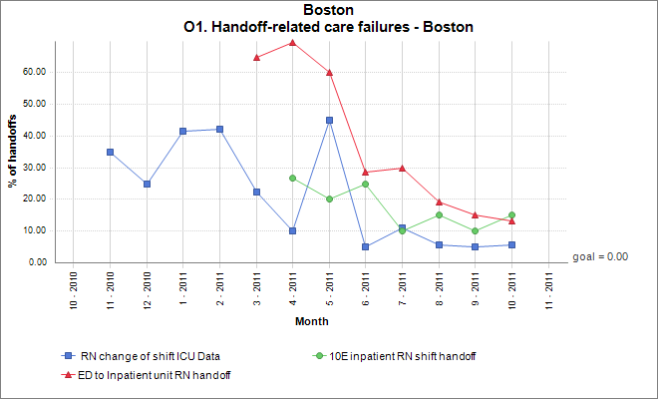
I-PASS for Nurses:
Handoff Related Care Failures
Bigham MT et al., Pediatrics 2014; 134: e572-579.

Slide 10
I-PASS Dissemination and Extension
Notes:
Nancy

Slide 11

I-PASS Mentored Implementation
16 Academic Institutions: Phase 1
Virginia Commonwealth University Hospital
Mayo Clinic
New York Hospital Queens
Maimonides Medical Center
Intermountain Medical Center
UCSD/University of California Medical Center
Arkansas Children's Hospital
University of Cincinnati
Brigham and Women's Hospital (IM and Surgery)
Levine Children's Hospital at Carolinas HealthCare System
Hurley Medical Center
Children's Hospital of Michigan
Trident Medical Center
University of Hawaii John A Burn School of Medicine
Sunnybrook Hospital-Ontario
Boston Medical Center
16 Academic Institutions: Phase 2
CHOP
New Hanover
Lankenau Medical Center
Children’s Hospital Montefiore, NY
Children’s Hospital Colorado
University of New Mexico
Hackensack UMC Mountainside
Medical University of South Carolina
Sparrow Hospital / Michigan State University
Johns Hopkins, Baltimore
Children’s National, DC
Toledo Children’s Hospital
AtlantiCare, New Jersey
Sanford Children’s Hospital, South Dakota
Gwinnett Medical Center, Georgia
Children’s Mercy, Kansas City

Slide 12
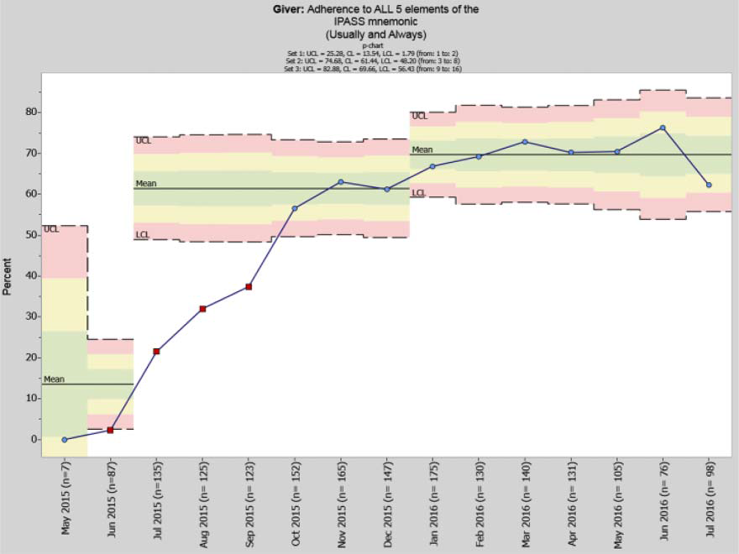
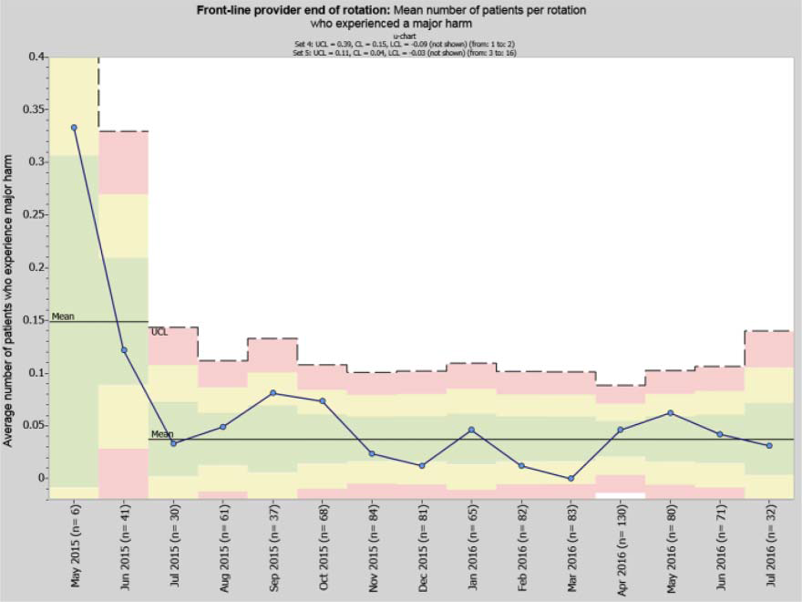
I-PASS Mentored Implementation
(1st 16 sites)
% adherence to all 5 elements mnemonic
Provider-reported adverse event rate

Slide 13
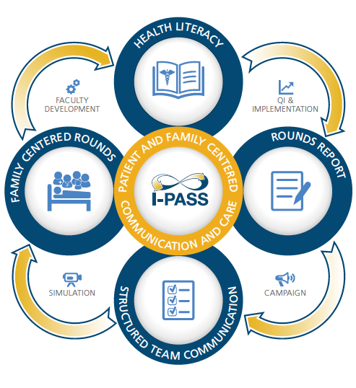
Adapting I-PASS For Patient & Family Centered Rounds
Patient and Family I-PASS Study
  Funded by a grant from PCORI
  Aim: To determine if improving communication and integrating patients/families into all aspects of decision making during hospitalization will
    Improve patient safety
    Improve patient and family experience

Slide 14

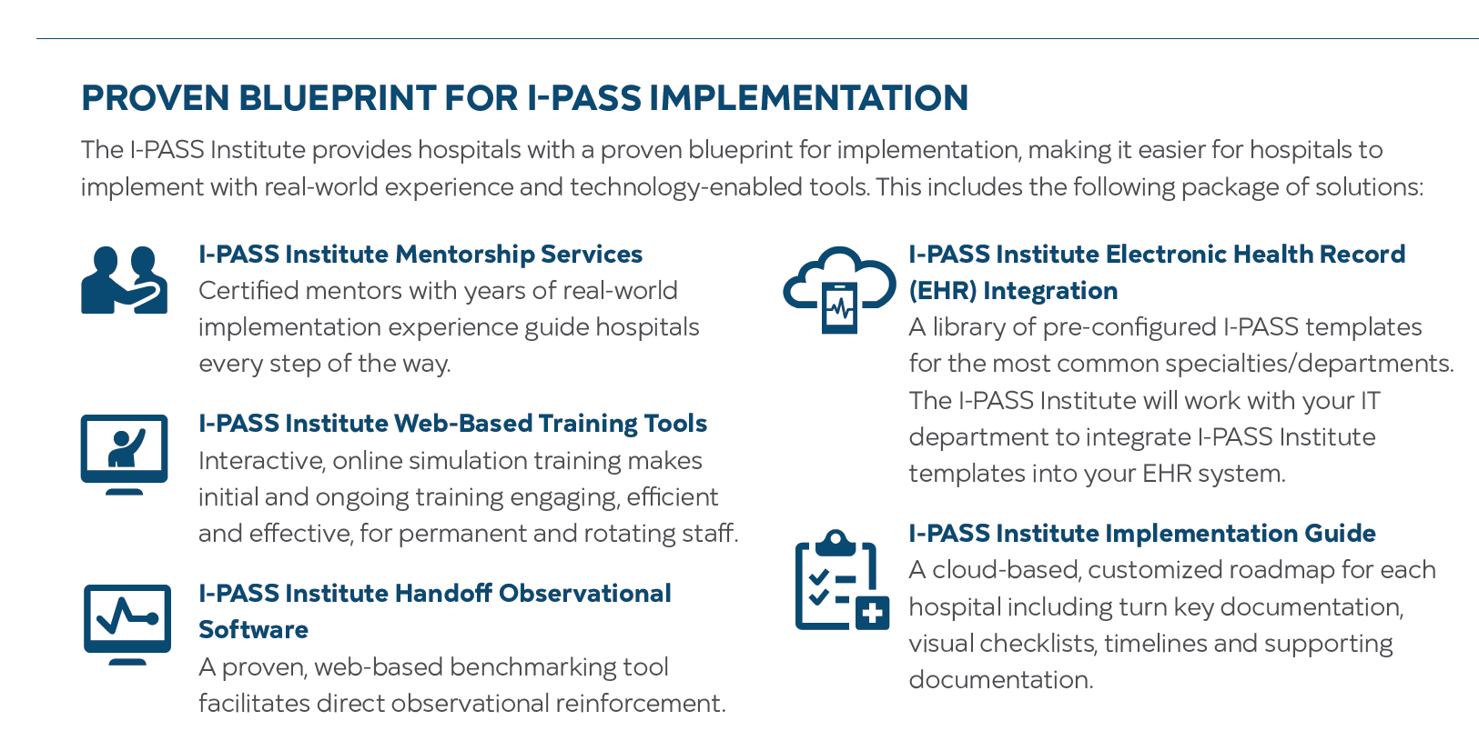
https://ipassinstitute.com/
Using our Evidence Based Bundle of Interventions

Slide 15
Contact Information
Christopher P. Landrigan, MD, MPH
Principal Investigator, I-PASS Study Group
Pediatric Hospitalist at Boston Children’s Hospital
Associate Professor of Pediatrics and Medicine at Harvard Medical School
Founder and Board Member of the I-PASS Patient Safety Institute
Email: CLANDRIGAN@PARTNERS.ORG
David M. Shahian, MD
Professor of Surgery, Harvard Medical School
Vice President, Massachusetts General Hospital Center for Quality and Safety
Email: DSHAHIAN@mgh.harvard.edu

Slide 16
Large scale I-PASS Implementation at a Tertiary Academic Medical Center
David M. Shahian, MD
Professor of Surgery, Harvard Medical School
Vice President, MGH Center for Quality and Safety
March 30, 2017

Slide 17
Handovers have not evolved with changes in healthcare
Healthcare has changed dramatically and handovers, which were never very good, have now become dangerously inadequate
  Greater range of diagnoses and treatments
  More practitioners involved in most patient’s care
  More sites where care is delivered (inpatient, ambulatory)
  Team-based care
  Work hours restrictions, cross-coverage, night floats
AMCs particularly vulnerable
  Size, case mix acuity, complexity
  Educational mission
We lag far behind other high reliability professions

Slide 18
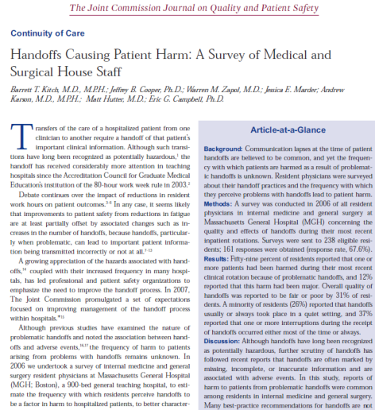
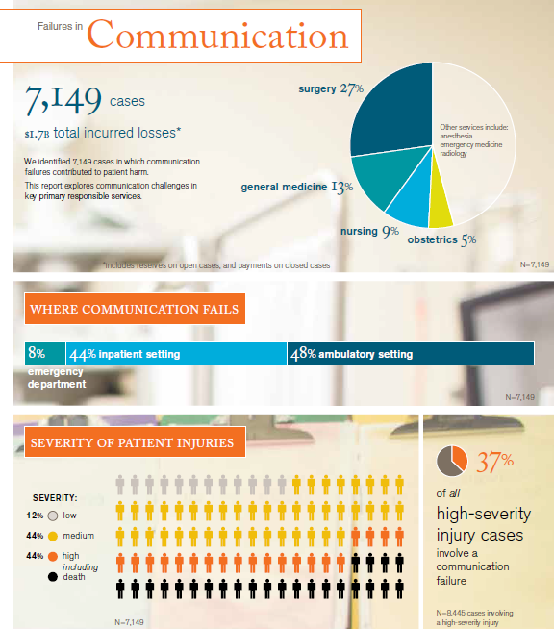
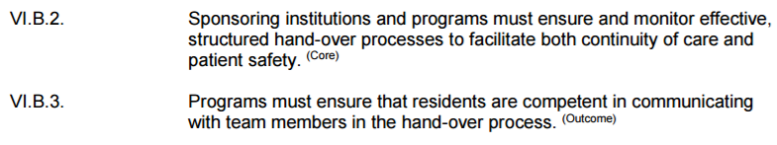
Why undertake a global handover initiative?
Lowest scoring safety culture survey domain
Our own published resident surveys (Kitch et al)
Center for Quality and Safety goals survey (#2)
Joint Commission Sentinel Event root causes
CRICO Strategies claims analyses (30% of claims)
Educational mission, ACGME Common Program Requirements

Slide 19
Why I-PASS?
Simple and intuitive
Accommodates multiple complex problems/tasks
Specifically designed for use in healthcare
Developed locally (Boston Children’s Hospital)—great colleagues!
Extensive educational materials
Widespread national and international interest
Empirical data demonstrating effectiveness

Slide 20
Why I-PASS?
  Standardized content, structure, sequence
  Verbal and written information transfer
  Interactive communication/dialogue
  Incorporates basic TeamSTEPPS training
  Deal with urgent or acute issues before handoffs
  “Sterile cockpit”—limit interruptions, focus on handover
  Explicit contingency planning
  Verification—”read-back” or “check back”

Slide 21
Massachusetts General Hospital
999 bed tertiary/quaternary academic medical center
Serves local patients from metropolitan Boston and suburbs
National and international referral center
51, 000 annual admissions, 106, 000 ED visits
21, 000 inpatient operations, 16, 000 outpatient procedures
Massachusetts General Physicians Organization (MGPO): multispecialty group practice, roughly 2,500 physicians
880 residents and interns, 4,800 RNs, nearly 25,000 full or part time personnel

Slide 22
I-PASS Phase 1: Initial training
Multidisciplinary MGH Handovers Committee
Center for Quality and Safety leadership
Senior MGH and MGPO leadership support
Universal training > 6,000 caregivers
  Multiple types and lengths of training
  Open forums, grand rounds, departmental meetings
  New resident orientation
  Varied educational content—lecture, videos, simulations
  Adapt I-PASS to caregiver and venue needs, workflows
  Norman Knight Center trained 4000 nurses
Necessarily asynchronous rollout over several years
Always start with rationale and evidence base for I-PASS
Start with shift to shift handovers

Slide 23
I-PASS Phase 1: Initial training
Workflow mapping, focus groups, demonstration projects
EHR as facilitator: I-PASS templates with some autopopulation
MGH policy change: I-PASS recommended, structured communication required
Local champions and local obstructionists
Measurement
  Kirkpatrick level 1: valuable experience?
  Kirkpatrick level 2: achieve educational objectives?
  Kirkpatrick level 3: applying new knowledge?
  Kirkpatrick level 4: impact on quality and safety?
Observations using paper or Smartphone app, follow results

Slide 24
I-PASS Phase 1: Initial training

Slide 26
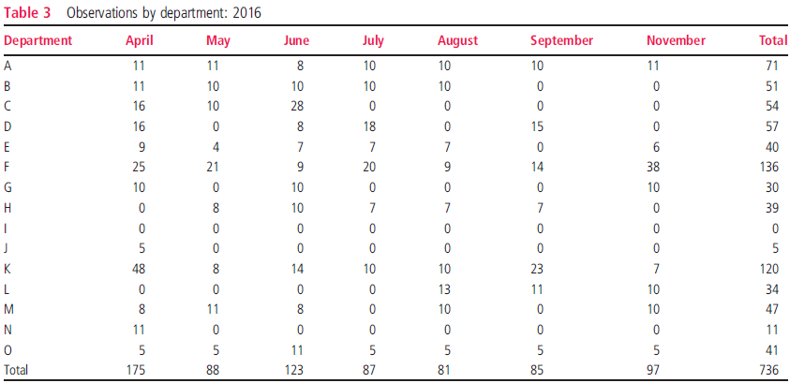
Substantial Variation in Departmental “Buy-In”
BMJ Quality and Safety, in press

Slide 27
Barriers
“Handovers in general are poor, but our service/unit does them well”
“I cross-cover too many patients—no time for a structured handover”
“Cook-book I-PASS formula doesn’t fit our workflow needs”
“You want me to repeat back everything—are you kidding!”
“This is just another paperwork mandate from administration that takes time away from patients”
Difficult to measure and isolate I-PASS related changes in outcomes (Kirkpatrick level 4)

Slide 28
I-PASS Phase 2: Adoption, spread, sustainability
Central role of Housestaff Quality and Safety Committee
Enhance and disseminate eCARE (Partners Epic) innovative practices
Cross-departmental, ambulatory, ED, Transplant
I-PASS Institute pilot studies (education, feedback, observations, benchmarking)
Imbed I-PASS eCare usage into Excellence Every Data Tracers
I-PASS Grants, CPIP projects
Peer-reviewed publications

Slide 29
I-PASS Phase 2: Adoption, spread, sustainability
Measuring success
  Kirkpatrick level 4 proxies—housestaff surveys?
  Repeat safety culture survey
  Handover-related safety reports
Imbed I-PASS into MGH culture

Slide 30
Contact Information
Christopher P. Landrigan, MD, MPH
Principal Investigator, I-PASS Study Group
Pediatric Hospitalist at Boston Children’s Hospital
Associate Professor of Pediatrics and Medicine at Harvard Medical School
Founder and Board Member of the I-PASS Patient Safety Institute
Email: CLANDRIGAN@PARTNERS.ORG
David M. Shahian, MD
Professor of Surgery, Harvard Medical School
Vice President, Massachusetts General Hospital Center for Quality and Safety
Email: DSHAHIAN@mgh.harvard.edu

